Slide 1
Exponential quantum speedup in simulating coupled classical oscillators
WOMANIUM QUANTUM + AI 2024
Ryan Babbush, Dominic W. Berry, Robin Kothari, Rolando D. Somma and Nathan Wiebe
By:
Vaishnav S Mallya

Slide 2

Harmonic oscillator
Harmonic oscillators are system of particles where there is an interconnecting force between particles which allows them to oscillate in place.
The key parameters which affect the oscillators are the mass of the particle (m) and force constant (𝜅). It is governed by Hooke’s law
Solving the equation will give us the oscillation frequency (𝝎)

Slide 3
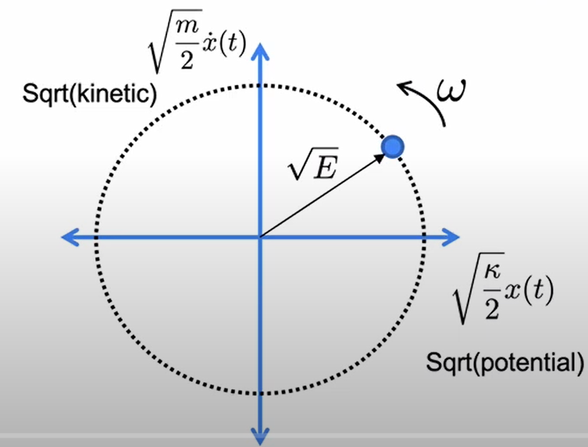
By conservation of energy, we can write total energy as
The phase space of energy will look like below

Slide 4
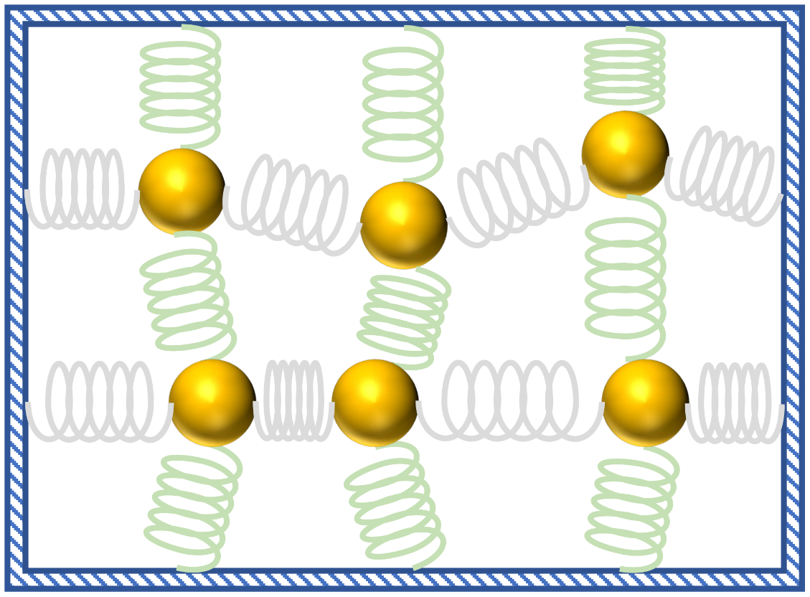
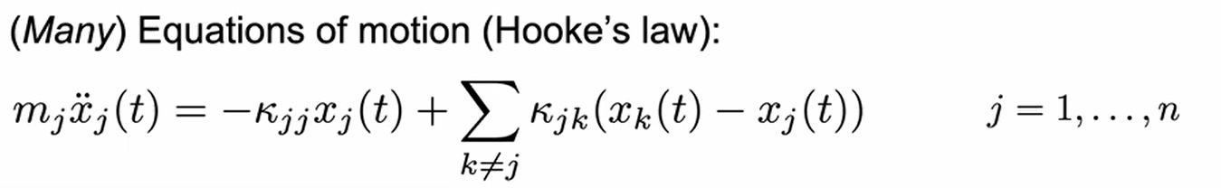
For a system of many oscillators, we require multiple values to specify each masses say N and N² number of spring constants assuming that masses interact with their neighbours.

Slide 5

Mapping the problem to a quantum computer
The harmonic oscillator satisfies Schrodinger’s equation
We can prepare an initial state and let it evolve based on the temporal part of Schrodinger’s equation.

